Slide 1
Defusing the sexuality debate
A History of Evangelical Responses to Sexuality

Slide 2
Where am I coming from?
These are complex questions involving real people.
No quick solutions.
The most significant moral challenge ahead of us as a church is how we disagree well as sisters and brothers in Christ.

Slide 3
How did we get to where we are?
1967 Decriminalisation of homosexuality
1988 Section 28 of Local Government act bans promotion of homosexuality
1991 Issues in Human Sexuality last report on sexuality accepted by Synod
2000-2010 Succession of legislative changes bringing equality for gay people
2008 Widespread boycotts of Lambeth Conference lead to establishment of Gafcon
2013 Same Sex Marriage Act. Pilling Report starts Listening Process
2017 Recommendations of Pilling rejected by Synod. LLF begins
2023 Prayers for Blessing same sex relationships approved by Synod, Issues becomes obsolete

Slide 4
What did Issues say?
The biblical understanding is marriage (understood as a lifelong, monogamous, heterosexual relationship) is the correct place for sexual expression. Homosexuality understood as non-equivalent to heterosexuality.
The conscience of gay lay people should be respected and they should be accepted as full members of the church.
Clergy as exemplary representatives of the church should not enter into sexually active homosexual relationships.
Notes:
The biblical material is complex, but converges on the ideal of marriage understood as a lifelong, monogamous, heterosexual relationship as the correct place for sexual expression. Homosexuality understood as non-equivalent to heterosexuality.
Chastity must be recognized as a special calling, distinct from singleness.
A conscientious decision by a gay layperson to enter into a committed monogamous same-sex relationship should be respected and they should be accepted as full members of the church.
Clergy as exemplary representatives of the church should not enter into sexually active homosexual relationships.

Slide 5
The issues with Issues
Dated language and ideas – ‘homophile’, reality of bisexuality denied, no engagement with trans issues.
Addressing different legal situation – no civil partnership, no same sex marriage, no children adopted by same sex couples etc
Encouraged a ‘don’t ask, don’t tell’ policy towards clergy.
Created a postcode lottery of provision for gay people. Some dioceses were liberal and offered services of blessing, others would take action against clergy who did.

Slide 6
What did Pilling recommend?
A period of debate and discernment leading to a new teaching document to replace Issues
Reconsideration of the distinction between lay and ordained in sexual ethics
Public services to mark permanent same sex relationships should be allowed (with a conscience clause) as a pastoral accommodation, but no liturgy should be provided

Slide 7
Pilling on public services of blessing
Oliver O’Donovan on ‘pastoral accommodation’.
Not an alteration in doctrinal position, but a pastoral response to those to whom for missional or pastoral reasons we want to reach out to in blessing even though they (like any of us) are not living lives entirely in line with God’s perfect intent.
Eg Remarriage of divorcees, prayers offered following the termination of a pregnancy, or blessings for those in a polygamous marriage.

Slide 8
Why were Pilling’s recommendations rejected in 2017?
Went too far and not far enough.
The 2017 General Synod took the unusual step of refusing to take note of the report, which effectively killed the whole process. LLF represents a fresh approach to the sexuality debate, a move to ‘radical Christian inclusion’.
Notes:
Rejected by conservatives who felt it conceded too much (the dissenting view of +Keith Sinclair appended to the report, was that Pilling legitimized a revisionist view of scripture).
Rejected by liberals who felt it represented no real change from Issues and therefore that the ‘Listening Process’ had not been engaged with in good faith.

Slide 9
The February Synod
Approved prayers of blessing, with a conservative amendment that these should not depart from existing doctrine.

Slide 10
Between the Synods
Prayers of Love and Faith
‘Resource Section’ and liturgies for ‘Stand Alone Services’
Theological Rationale
Liturgy for times of uncertainty - a ‘pastoral accommodation’ (became increasingly apparent this would be a focus for legal challenge)
Pastoral Guidance
To ensure parity of provision across dioceses, allow for conscience clauses, and the possibility of ‘structural differentiation’

Slide 11
The November Synod
Agreed approval of PLF with conscience of clergy and will of PCC respected. Liberal amendment to include standalone services on trial basis.

Slide 12
Responses to the November Synod
The HoB has commended PLF. Standalone services not yet commended as experimental liturgy. Consultation on diocesan basis before returning to Synod for authorization. A fuller version of Pastoral Guidance will be issued and is anticipated to address question of clergy in same-sex marriages.
The CEEC has announced its Ephesian Fund – a centralized ‘stewardship fund’ as an alternative to paying diocesan share, and plans for alternative episcopal oversight that parishes can opt into. This is significantly more autonomy than in the HoB proposals.
Liberals have generally welcomed the vote. Evangelicals are becoming more visibly divided. Inclusive Evangelicals were more visible at Synod. Conservatives are splitting between a more tolerant group determined to stay within existing structures and a more separatist group seeking clear structural differentiation and parallel structures.

Slide 13
Understanding Evangelicals and Sexuality

Slide 14
The Evangelical Consensus position on sexuality
All Christians accepted as full members of the church regardless of sexual orientation. Homophobia is to be condemned.
Engaging in any same-sex sexual activity is sinful, but only on the same basis as any sexual relationship outside of marriage.
Marriage is only between opposite sex couples, and sex outside of marriage cannot be celebrated in a church context, or seen as equivalent to marriage.

Slide 15
Biblical basis for the Evangelical Consensus
Genesis 1&2 - Jesus sees as foundational. Paul refers to it.
Seven direct references to same-sex sexual relationships in the Bible are consistently negative.

Slide 16
Presuppositions
This position and understanding of scripture represents the tradition of the church, held unvaryingly for centuries.
Scripture is so clear on this point that departure from it represents simple refusal to submit to the authority of scripture, making this a ‘first order’ issue, where disagreement between faithful Christian disciples is not possible.

Slide 17
My argument
The tradition of the church has not historically held an unvarying position equivalent to the Evangelical Consensus position. Nor has it held to the understanding of scripture Evangelicals draw upon to support the Consensus position for centuries. Both are essentially 20th century understandings.
This does not mean that they are not the right understanding. Simply that it cannot be plausibly argued that either the position currently held by evangelicals or the interpretation of scripture behind it had been set out in this way prior to the Seventies, even if it is argued that it is a legitimate development of earlier tradition. It is therefore misleading to describe the Consensus position as ‘Traditional’ and more liberal understandings as ‘Revisionist’. Both conservative and liberal stances are Revisionist.
This means that departure from the Consensus position cannot be argued to be seen as a ‘First Order’ issue. Most Christians (and, in fact, most evangelicals) throughout history have not held this position and other positions that could also be argued to be legitimate developments of earlier tradition (ie the ‘Revisionist position’) are also possible.

Slide 18
The Tradition before The Tradition
Christian tradition prior to the twentieth century held to an unvaryingly negative view of homosexuality (and not simply homosexual acts), but this was not expressed in the form of the Evangelical Consensus position, and it did not draw on the same configuration of biblical texts to support it.

Slide 19
The Tradition before The Tradition
There are two key aspects to this:
No understanding of ‘orientation’. Pre-modern Christians give no indication that they see homophobia as something to be condemned or gay people to be affirmed whilst homosexual acts are condemned.
No reference to Genesis 1&2 key text. Genesis 19 (the Sodom narrative) and Romans 1. When pre-modern Christians offer interpretations of Genesis 1&2 as part of an understanding of marriage they stress procreation as key.

Slide 20
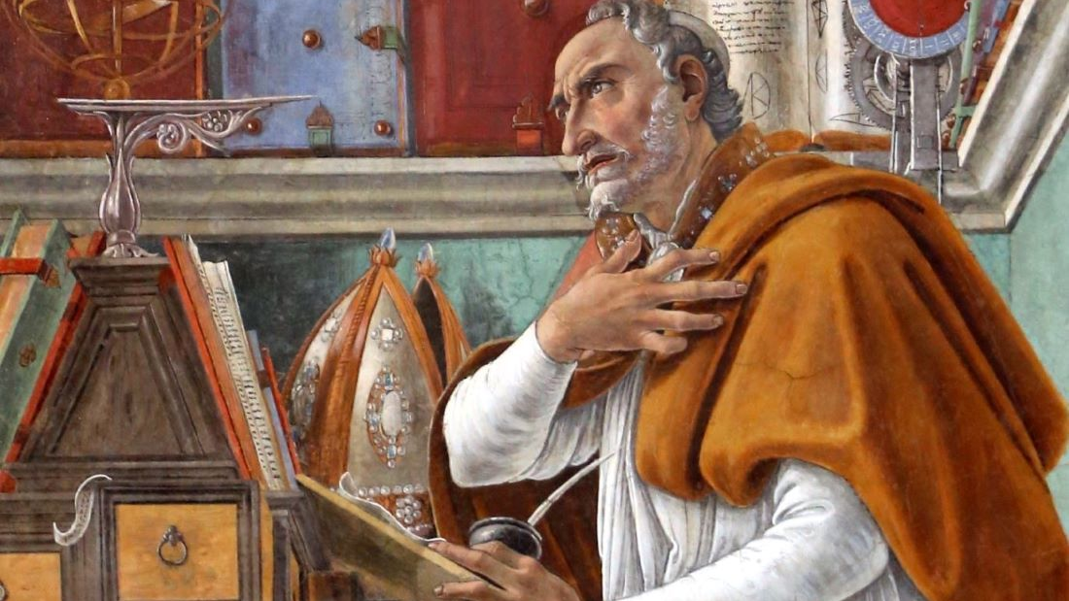
Augustine’s Confessions 3:8
Therefore are those foul offences which be against nature, to be every where and at all times detested and punished; such as were those of the men of Sodom: which should all nations commit, they should all stand guilty of the same crime, by the law of God, which hath not so made men that they should so abuse one another. For even that intercourse which should be between God and us is violated, when that same nature, of which He is Author, is polluted by perversity of lust.
Notes:
When Augustine wants an example of an offence against nature he thinks of homosexuality, a ‘perversity of lust’, but he interprets homosexuality theologically by reference to God’s judgement on Sodom.

Slide 21
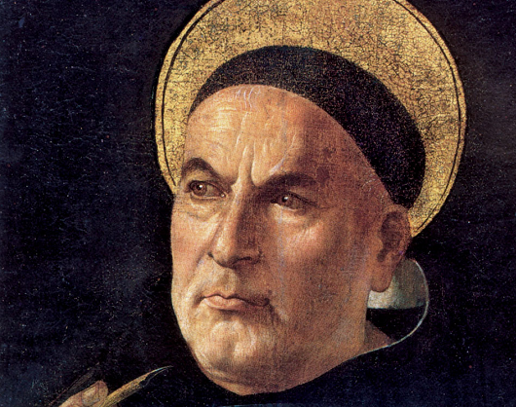
Aquinas Commentary on Romans 1: 18-29
“[Paul] says therefore first… that since [the Gentiles] changed the truth of God into a lie, ‘God gave them up,’ not, indeed, impelling them to evil, but deserting them ‘in ignominious passions,’ that is, in sins against nature… something is said to be against the nature of the human being by reason of the genus, which is ‘animal.’ Now, it is manifest that, according to the act of generation, whence all manners of intercourse, from which generation cannot follow, are against the nature of the human being insofar as the human being is animal…
And therefore it is to be noted that the Apostle asserts the penalty for idolatry reasonably enough as the vice against nature, which is the gravest among the carnal sins, since it seems to have begun at the same time as idolatry, namely in the time of Abraham, when idolatry is believed to have begun. For that reason and at that time it is first read of as having been punished among the Sodomites in Genesis 19.”
Notes:
Aquinas does not interpret Genesis 19 by reference to Romans 1, still less by reference to Genesis 1&2. Instead, he interprets Romans 1 by reference to Genesis 19 with no reference to Genesis 1&2.

Slide 22
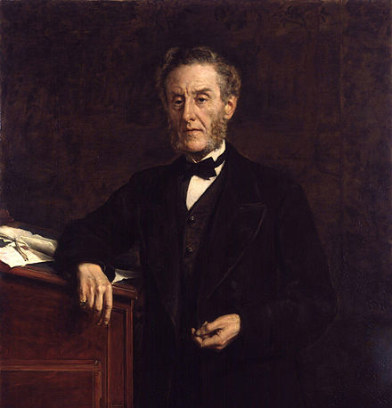
Evangelicals and Homosexuality
Little discussion prior to the twentieth century.
Buggery Act of 1533 made sodomy a capital crime, only being reduced to life imprisonment in 1861.
19th Century Evangelicalism campaigning on reform of laws around prostitution for the protection of children, but no interest in condemning homophobia.
1885 Criminal Amendment Act, replaced the prohibition of ‘buggery’ with a prohibition of ‘gross indecency between men’, heavily lobbied for by the SPCC.
Notes:
Homosexuality has not been a topic much discussed by Evangelicals prior to the twentieth century. At the time of the 18th Century Great Awakening (recognised as the birth of Evangelicalism), the Buggery Act of 1533 was still in force. This made sodomy (an offence that was generally understood to equate to male gay sex, but not female gay sex, and could also be committed by a male-female couple) a capital crime, only being reduced to life imprisonment in 1861.
In the 19th Century, as Evangelicals became politically influential and began to become more interested in public morality, campaigning on reform of laws around prostitution for the protection of children, they showed no interest in condemning homophobia. In fact, the 1885 Criminal Amendment Act, which notoriously replaced the prohibition of ‘buggery’ with a prohibition of ‘gross indecency between men’, (widely recognised as turning it into a blackmailer’s charter that opened the door to homophobic malicious prosecution), was passed by Parliament largely due to heavy lobbying by the SPCC, founded by the evangelical Lord Shaftesbury the year before. It can be argued that evangelicals had not intended this – it was due to a malicious and misunderstood amendment by Henry Labouchere MP (himself agnostic), but they certainly showed no concern over it. Condemning homophobia was transparently not a concern for them.

Slide 23
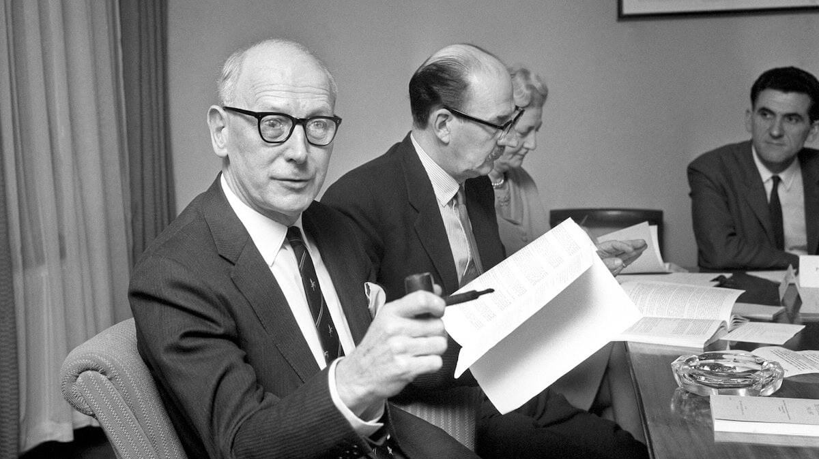
Wolfenden
Evangelicals largely absent from debate decriminalisation.
The Great Reversal - splits between Liberal and Conservative Evangelicals in the early 20th century meant Evangelical withdrawal from social action until they re-engaged in 1960s, under the leadership of John Stott.
Notes:
Reform of the 1885 law in order to prevent homophobia was widely recognised as necessary following some high-profile prosecutions, and the Church of England was a significant driving force behind the drive for reform, that would lead to the Wolfenden Report and eventually the decriminalisation of (male) homosexuality in 1966. However, evangelicals were largely absent from this. Splits between Liberal and Conservative Evangelicals in the early 20th century had led to what Bebbington calls ‘The Great Reversal’, where the Evangelicals so active in social justice in the 17th and 18th centuries withdrew until they re-engaged in 1960s, under the leadership of John Stott.

Slide 24
Constructing a social ethic for a new legal reality
Issues Facing Christians Today in 1984.
Accepts the CofE’s post-Wolfenden position on homosexuality: that although homosexual acts are sinful, they should not be illegal. The rights and freedoms of gay people are to be respected, and homophobia is to be deplored, though Christian disciples should not enter into or bless gay relationships.
Implicitly accepts Sherwin-Bailey’s argument that existing tradition is unhelpful – constructs new ethic on Genesis 1&2, and a Christian understanding of male-female marriage.

Slide 25
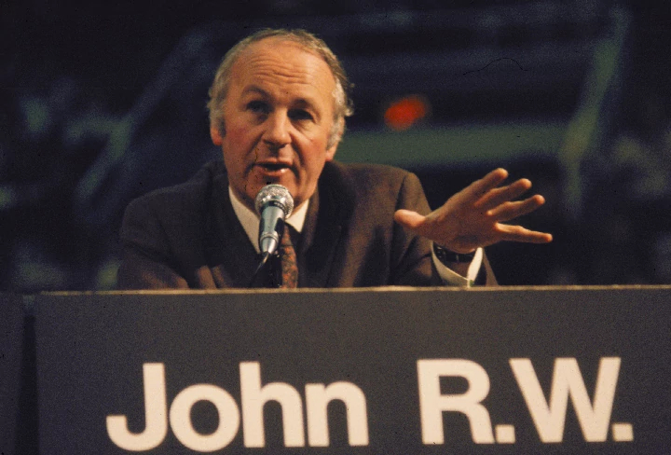
Repenting of a homophobic past
Early evangelical teaching has a clear concern to condemn homophobia and repent of the church’s past – this alone marks this out as a revisionist position.
“[The Christian can offer] a welcome for those whom society ostracizes; and a desire to educate both young inverts themselves and those among the heterosexual majority whose attitude towards homosexuals is compounded of suspicion and misunderstanding.” Field p23 1976
“…it is incumbent on the wider Christian fellowship to repent of its attitudes of rejection, and work at being the fellowship of support in which the summoning of practising homosexuals to repentance and change in their lifestyle… can be made realistically in the context of warm and supportive charity, and not cold pharisaic legalism… a recognition of [the fact that homosexuality is involuntary]… should provoke sympathetic and caring responses rather than moralistic abhorrence or legalistic coercion.” Atkinson p118 1979
“..love is just what the church has generally failed to show to homosexual people.” Stott p320 1984

Slide 26
A developing tradition
Stott (1984) was the first to make Genesis 1&2 central, with other passages essentially reduced to the margins.
There has been a general tendency towards re-emphasising the significance of the traditional passages.
Wright (1984) made a strong case for understanding the hard-to-translate arsenokoites (in 1 Cor 6 and 1 Tim 1) as a neologism derived from the LXX version of Leviticus 18

Slide 27
A developing tradition
By the 90s evangelicals started asserting a fixed and exclusive same-sex attraction was understood in the ancient world, so texts cannot be dismissed as marginal. This is particularly emphasised in Schmidt (1995).
Gagnon (2001) makes much stronger case for sexual complementarity as written into the created order, and traditional passages (including Genesis 19) as rooted in this basic understanding. No real focus on or interest in condemnation of homophobia.
Disagreement between figures like Gagnon and Hays on whether first order issue.
Notes:
By the 90s evangelicals were more robust in asserting that the concept of people having a fixed and exclusive same-sex attraction was understood in the ancient world, so biblical condemnations of homosexual acts must be understood as applying to gay people as well as bi and straight people. (The fact that act and desire are not clearly distinguished in some of these condemnations has generally not been recognised in this re-assertion). This is particularly emphasised in Schmidt (1995).
Gagnon (2001) particularly influential in both making a much stronger case for the Genesis 1&2 understanding of sexual complementarity as written into the created order, and re-asserting the continued significance of all the traditional passages (including Genesis 19) as rooted in this basic understanding of sexual complementarity. He strongly asserts a case for seeing homosexual cult prostitution as a significant part of ANE religious culture and a significant issue in Israel. No real focus on or interest in condemnation of homophobia.

Slide 28
Summary
The Evangelical Consensus Position is a revisionist development of earlier pre-modern Christian tradition. It represents a different stance towards homosexuality, on the basis of a new interpretation of scripture, drawing on different passages, and building on a revisionist understanding of Christian marriage.
This is a developing and broad tradition, which contains disagreement. There are multiple different versions of ‘the evangelical position on sexuality.’

Slide 29
Some advice for a divided church
Avoid declarations that adherence to particular positions represent first order issues of faith – allow space for doubt
Depolarise the debate – slow down the cycle
Avoid demonising modernity
Stay humble and listen openly
Recognise the complexity of the conversation

